Slide 1
What’s new in Docker 1.13.0
spoiler alert: a lot!!
Victor Vieux / vieux@docker.com / @vieux

Slide 2
Restructure CLI commands
docker images -> docker image list
docker create -> docker container create
…
docker build and docker run unchanged
fully backward compatible, legacy commands still showed in --help.
Use DOCKER_HIDE_LEGACY_COMMANDS=1 to hide legacy commands.

Slide 3
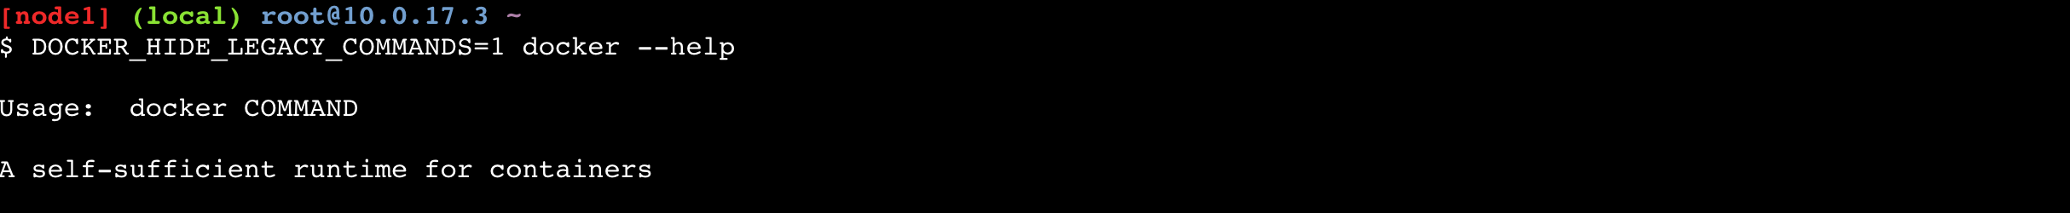
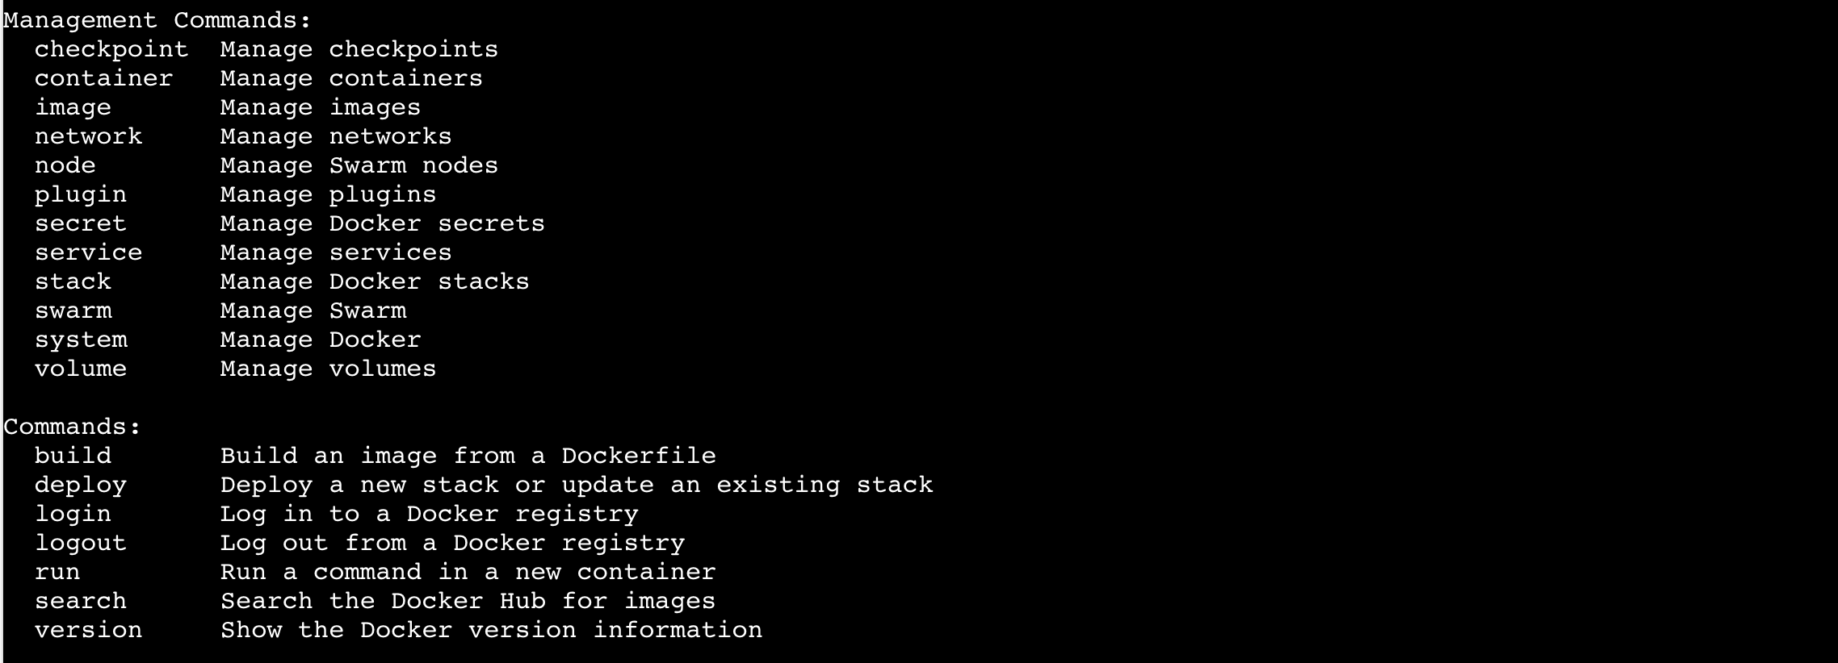

Slide 4
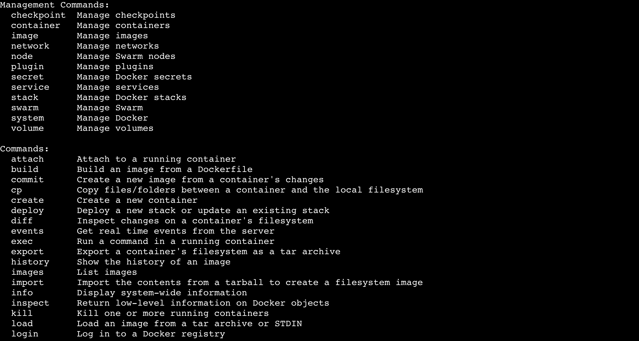

Slide 5
Experimental not a separate build anymore
--experimental added to the dockerd
docker will round-trip with the daemon to show
usage accordingly.

Slide 6
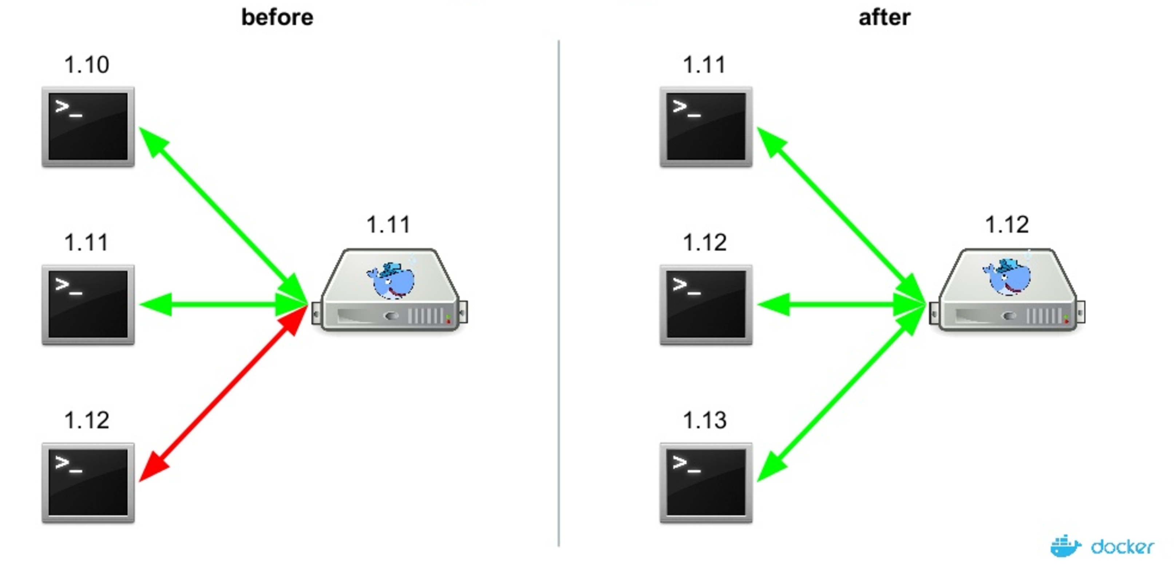
CLI backward compatibility
An older cli will now be able to talk to a newer daemon (same round-trip as experimental).

Slide 7
Default encryption at rest
All of the data stored in swarm mode is encrypted at rest, and allows users to own key
docker swarm update --autolock
docker swarm unlock
docker swarm unlock-key --rotate

Slide 8
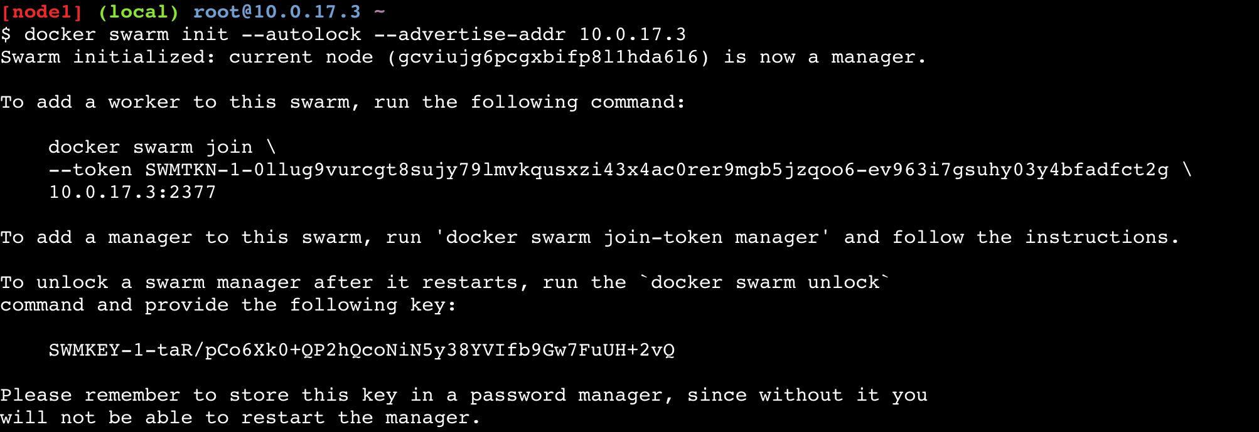
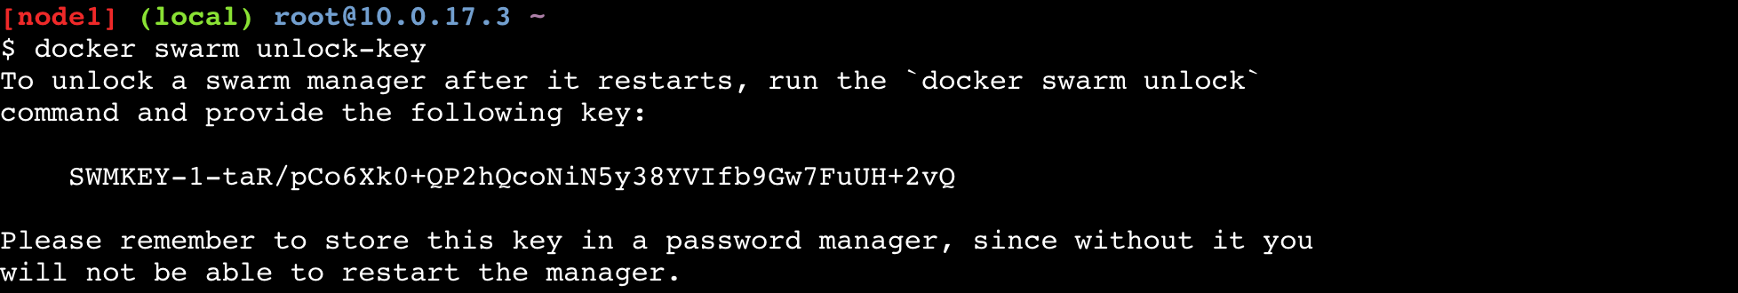

Slide 9
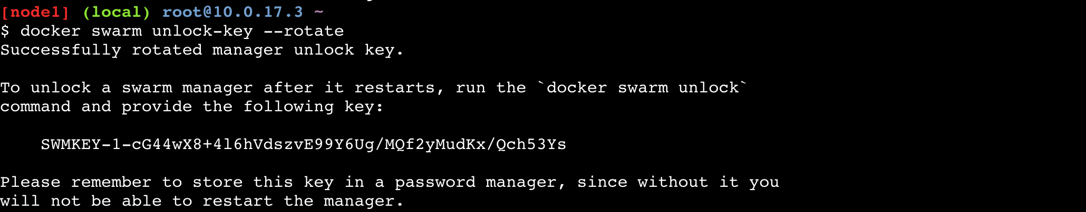

Slide 10
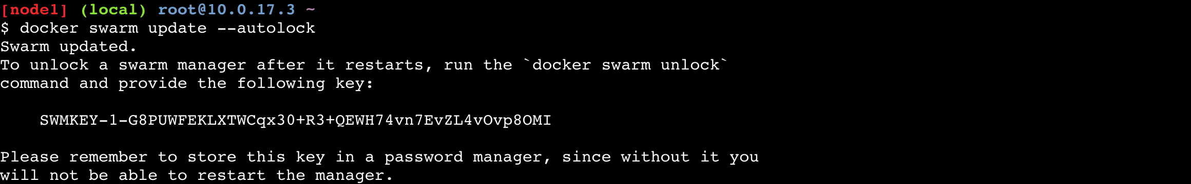

Slide 11
Secrets Object - Only in Swarm mode
A new secrets object, along with API endpoints and CLI commands
Available in swarm mode only
Secrets are stored in the Raft log associated with the swarm cluster
Mounted in tmpfs inside a container
Secrets are immutable
docker secret create SECRET_NAME FILE (may be STDIN)
docker secret rm SECRET_NAME
docker secret inspect SECRET_NAME
docker service create --name app --secret SECRET_NAME my_app
Notes:
secrets in Docker swarm mode are immutable
writing secrets to the raft log, which means they are replicated to each of the manager nodes. The Raft log on each manager node is held in memory whilst the cluster is operating, and is encrypted in Docker 1.13.0+.

Slide 12
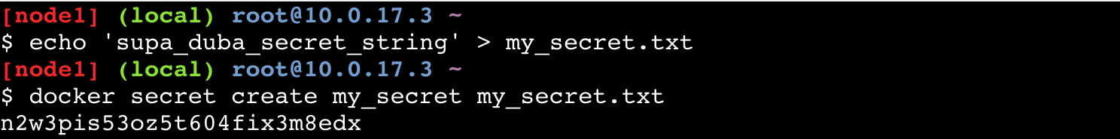
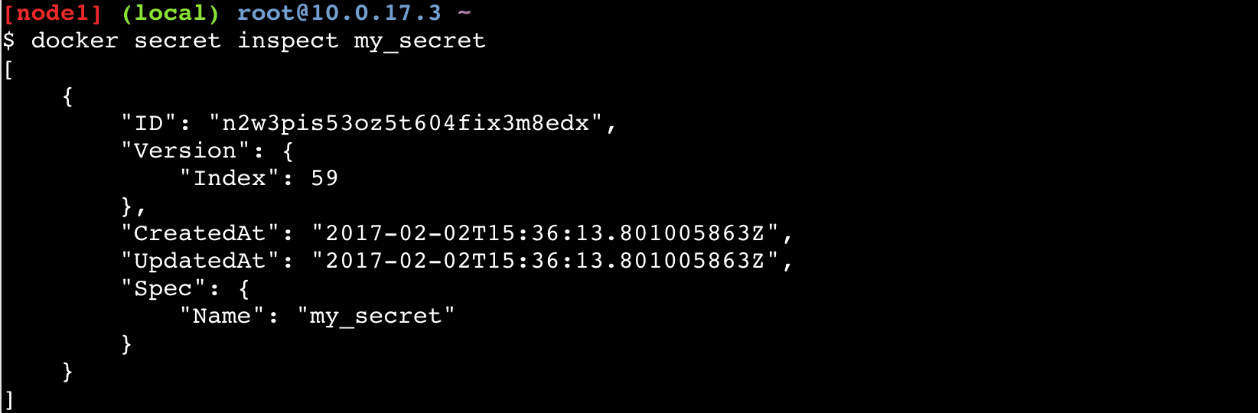
Create a secret

Slide 13
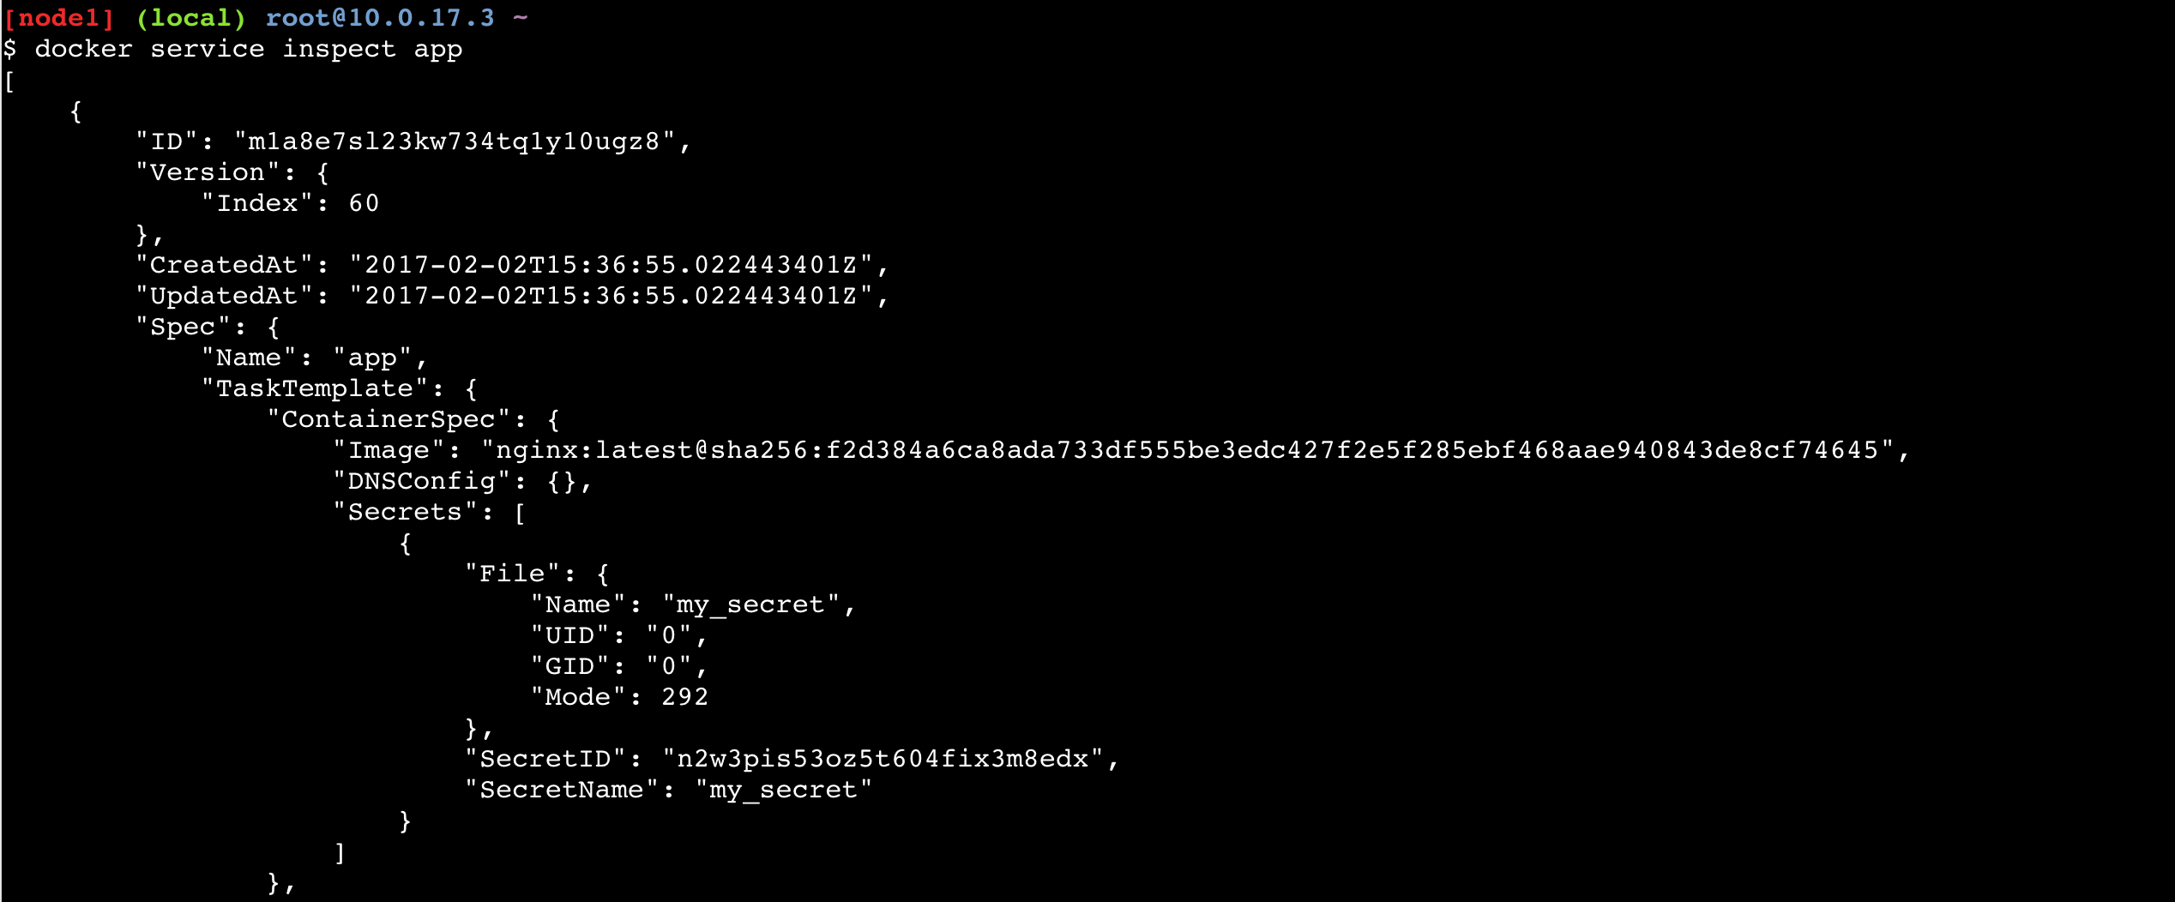
Use a secret

Slide 14
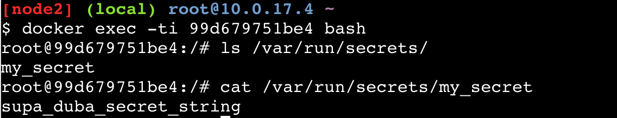
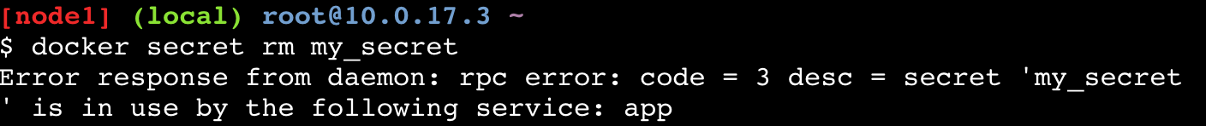
Use a secret / Delete a secret
Notes:
Voir un secret
Ne peut pas supprimer un secret in use

Slide 15
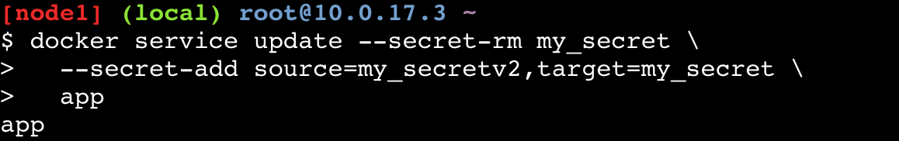
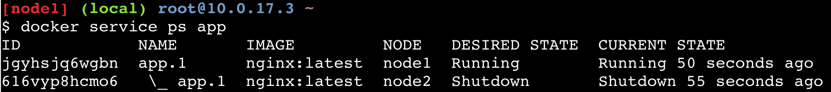
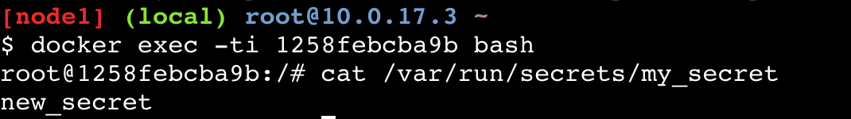
Rotate a secret
Notes:
secrets are immutable
create
update service -> start new container
--update-parallelism and --update-delay flags (1 and 0s by default, respectively)

Slide 16
Plugins out of experimental
docker plugin create vieux/sshfs /path/to/rootfs
docker plugin enable vieux/sshfs
or
docker plugin install vieux/sshfs
docker plugin set vieux/sshfs DEBUG=1

Slide 17
Compose to Swarm
docker stack deploy --compose-file= foo
docker stack list
docker stack rm foo
New v3 compose format, difference from v2:
Removed the non portable options (build, volume-from, etc…)
Added Swarm specific options (replicas, mode, etc…)

Slide 18
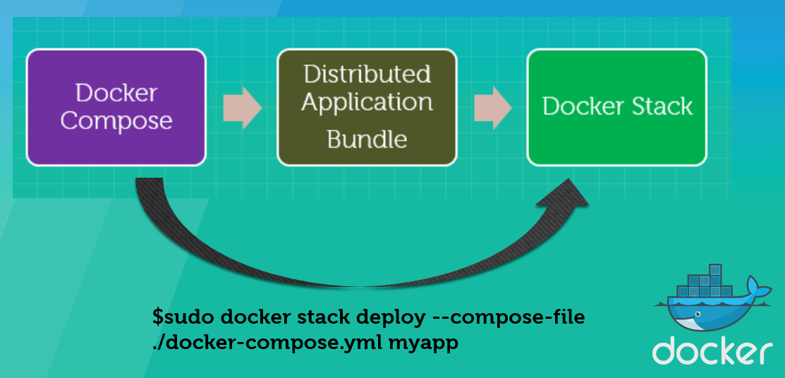
Compose to Swarm

Slide 19
Data management commands
docker system df to show docker disk usage.
docker system prune to remove unused data.
docker container/image/network/volume prune

Slide 20
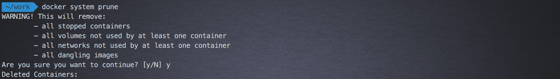

Slide 21
(experimental) other features
docker build --squash will produce only one layer.
docker service logs to show aggregated logs of a service.

Slide 22
docker-init
New binary docker-init is now shipped with docker to kill zombies processes.
It uses tini, but can be replaced by your own with --init and --init-path on dockerd

Slide 23
A bunch of new flags
docker build --network
docker service create --host
docker service create --tty --hostname --dns …

Slide 24
Various Orchestration Enhancements
Pin image by digest for rolling updates redis:latest -> redis:latest@sha256:13478120c…
Service update failure thresholds and rollback

Slide 25
Various Orchestration Enhancements
HA scheduling, spreads out tasks from a service
Improvements to constraints, UX
Provide reason for unschedulable tasks
Global services should obey constraints
Remove tasks that no longer satisfy constraints

Slide 26


